Slide 1
Acoustic Fingerprinting Dhairav Chhatbar

Slide 2
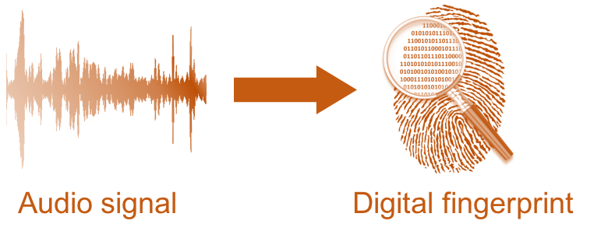
Project analysis slide 2
What is Acoustic
Finger Printing?

Slide 3


Project analysis slide 2
Practical
Applications?
What is this song?

Slide 4

Project analysis slide 2
Practical
Applications?

Slide 5
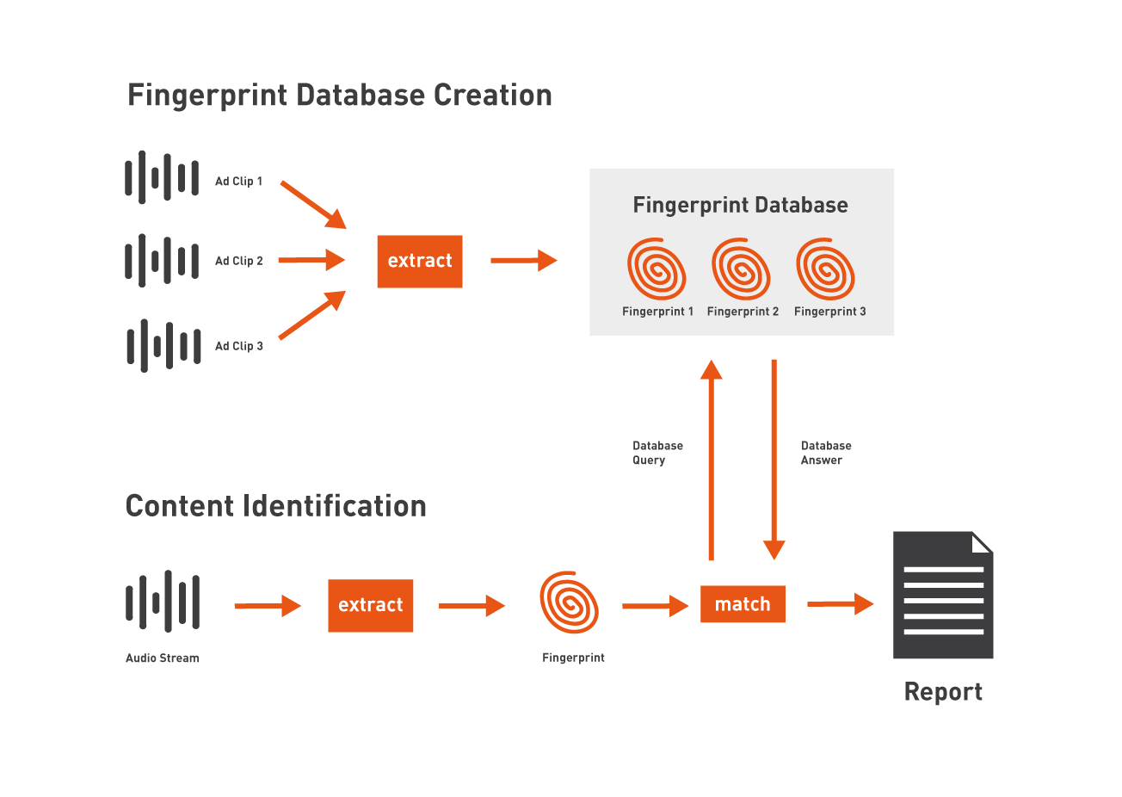
Project analysis slide 2
How does it work?

Slide 6
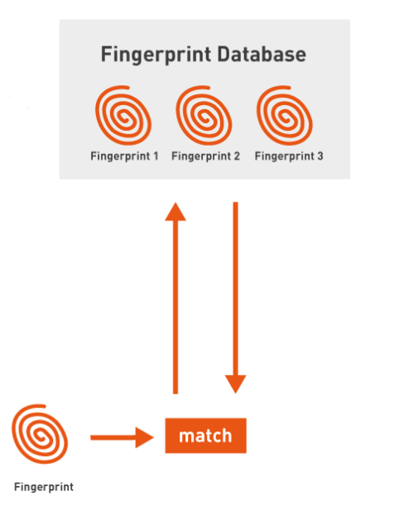
Project analysis slide 2
How does it
REALLY work?
Spectrograms
Spectrogram Peaks
Hashing

Slide 7
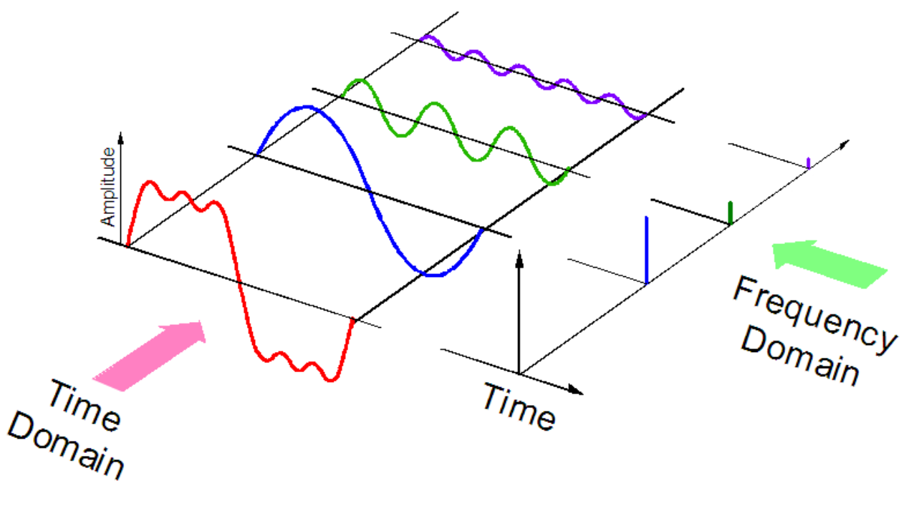
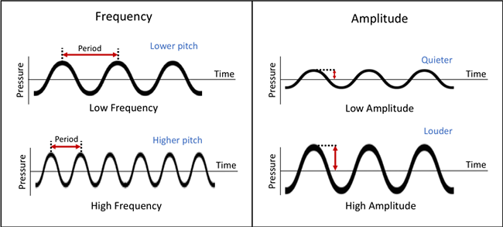
Project analysis slide 2
Some Basics –
What is sound?
At a very basic level sounds are vibrations that travel through the air or another medium and can be heard when they reach a person’s ear
A sound signal can be represented in 3 generic parameters:
Frequency
Amplitude
Time
Frequency: speed of the vibration, and this determines the pitch of the sound
Amplitude: size of the vibration, and this determines how loud the sound is

Slide 8
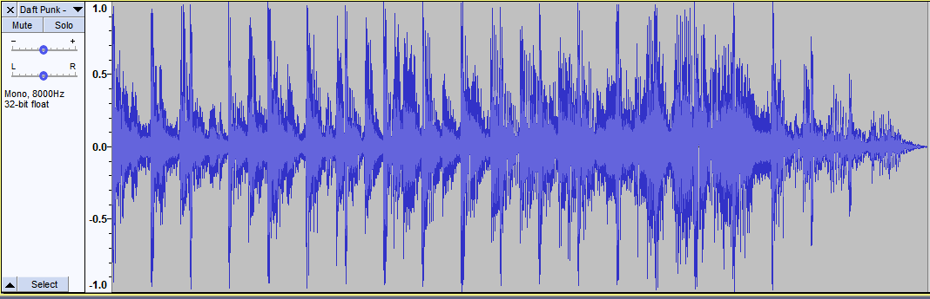
Project analysis slide 2
Some Basics –
Visualizing sound
When we want to visualize the sound/music the most frequent method of visualization is a waveform. It displays:
x-axis: Time
y-axis: Amplitude
While a waveform us very useful and practical for many sound editing applications, it does not display the frequency

Slide 9
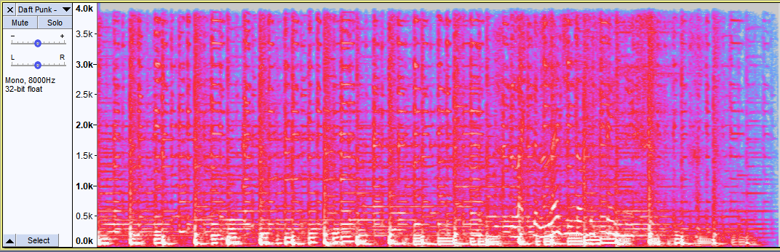
Project analysis slide 2
Spectrograms
Spectrograms allow the visualization of all 3 elements on a sale
x-axis: Time
y-axis: Frequency (lowest frequencies at the bottom and the highest frequencies at the top)
Heat map/color saturation: Amplitude

Slide 10
Project analysis slide 2
Spectrograms

Slide 11
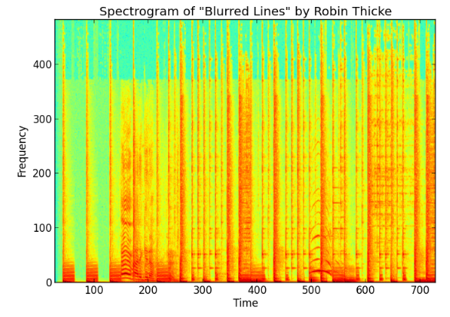
Project analysis slide 2
Spectrogram Peaks
Spectrogram of Blurred Lines – Robin Thicke
Red = higher amplitude
Green = lower amplitude
Spectrograms are primarily used to fingerprint audio

Slide 12
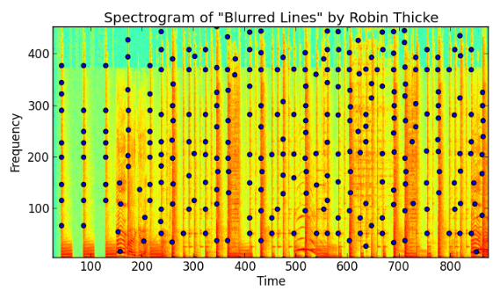
Project analysis slide 2
Spectrogram Peaks
Spectrogram by itself has too much information to quickly fingerprint a song
Why are peaks used? A recording has to account for
Signal quality degradation (Radio station signal >> recipient speakers >> cell phone recording)
Background noise
Peaks saved as data points (time/frequency pairs)
Time offset also stored
Amplitude datapoints discarded
Peak Spectrogram called “constellation map”

Slide 13
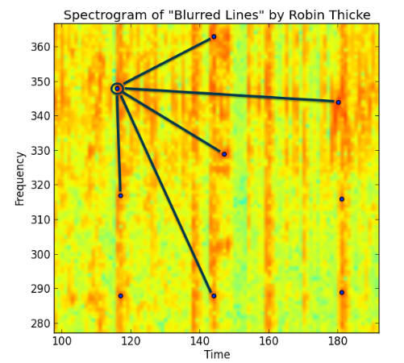
Project analysis slide 2
Hashing
Specific peaks are identified as “anchor points” and are paired with other peaks
Using the time offset, each pair is hashed
hash(frequencies of peaks, time difference between peaks) = fingerprint hash value
Combination of hashes are stored as the “fingerprint” of a song
Time offset also stored
For a time slice of audio the amount of hash matches are compared
To match a song, the hashes of a recoded song are matches against hashes of already cataloged songs. The amount of hash matches determine what the algorithm will suggest as a match. It doesn’t have to be 100% matches
“Blurred Lines” by Robin Thicke has approx. 180k hashes

Slide 14
Project analysis slide 2
References
Sound Analysis and Synthesis with R (Use R!)
ISBN- 13 : 978-3319776453
Fingerprinting with Python and Numpy
https://willdrevo.com/fingerprinting-and-audio-recognition-with-python/
A Short Introduction to Audio Fingerprinting with a Focus on Shazam
http://hpac.rwth-aachen.de/teaching/sem-mus-17/Reports/Froitzheim.pdf
Music Genre Classification with Python
https://towardsdatascience.com/music-genre-classification-with-python-c714d032f0d8

Slide 15
Thank You

